Slide 1
PELVIC EXAMINATION
DR. L. GIRIJA. M.D. (Hom.),
Associate professor,
DEPARTMENT OF GYNAECOLOGY AND OBSTETRICS,
SARADA KRISHNA HOMOEOPATHIC MEDICAL COLLEGE,
KULASEKHARAM

Slide 2
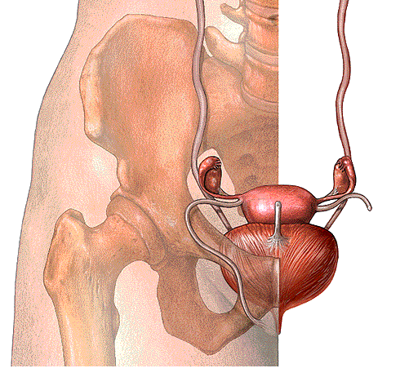

Slide 3
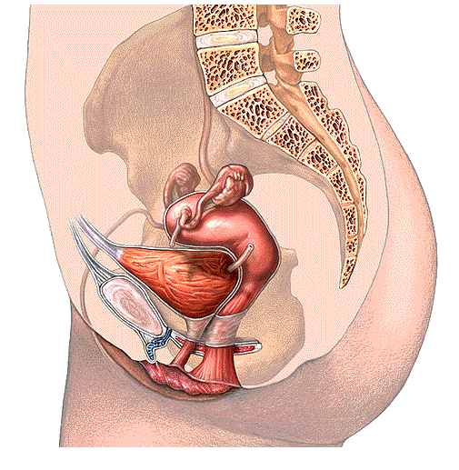

Slide 4
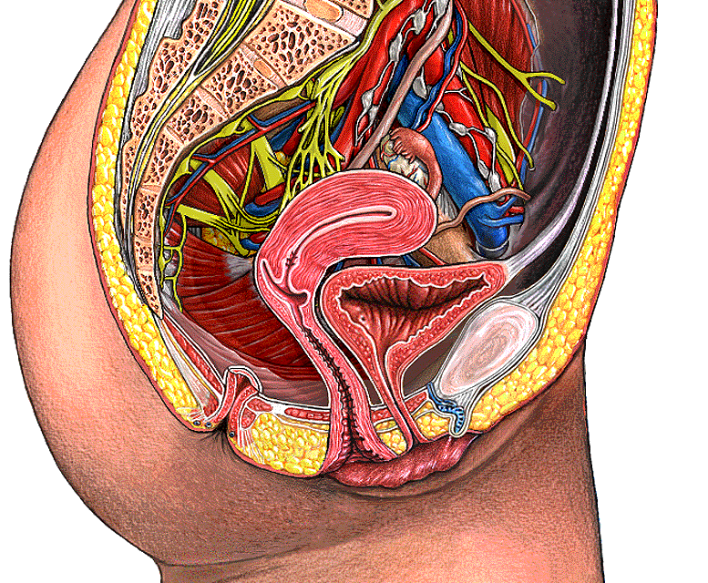

Slide 5
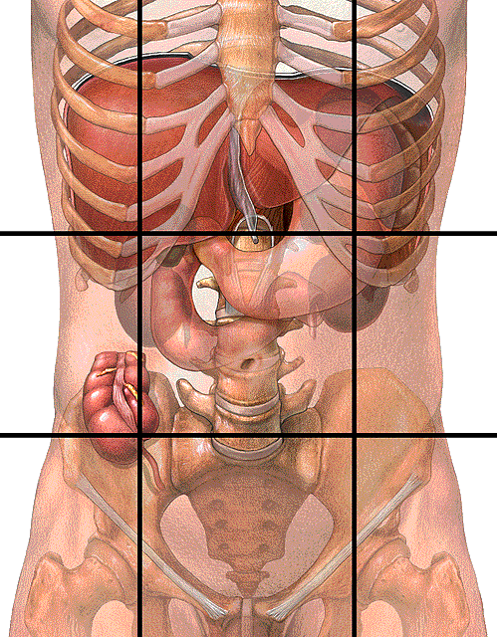

Slide 6
PELVIC EXAMINATION
1. Preparation of the patient:
  A. Instruments for pelvic examination:
    1. examining gloves
    2. bivalve speculum (plastic or metal) (various sizes)
    3. sponge forceps
    4. cotton balls
    5. wooden spatula
    6. Cyto brush
    7. 2 glass slides or whatever your clinic uses
    8. fixative, liquid or spray

Slide 7
Use firm pressure, not a light tickling touch
  Talk to the patient and tell her what you are doing.
  Look at the patient when you ask her a question, if you can.
  But, maintain eye contact and stay in touch with the patient’s response.
  Be sensitive
  The patient must have an empty bladder

Slide 8
Pelvic examination
Inspection of ext.genitalia
Vaginal examination
-Inspection of Cx,& vaginal walls
- Palpation of vagina & vaginal Cx by digital examination
-Bimanual examination of pelvic organs
Rectal examination
Recto-vaginal examination

Slide 9

Examination of external genitalia
A. Clitoris
B. Prepuce
C. Labia majora
D. Labia minora
E. Perineal body
F. Hymen
G. Urethral meatus

Slide 10

H.Vestibule
I. Bartholin’s glands (greater vestibular)
J. Skene’s glands (Para urethral) -
K.Lesions, discharge
Pubic hair pattern
ANY ANATOMICALABNORMALITIES,
ANY PALPABLE PATHOLOGY OVER THE AREA

Slide 11
Bartholin’s glands and Skene’s glands are normally non-palpable; swelling and tenderness indicate abnormality (e.g., abscess)
Test for relaxation of supporting structures:
  Palpate perineal tone.
  Patient is told to hold breath and strain ; involuntary loss of urine; or descent of vaginal wall, or cervix to the introits indicates abnormality. Inquire about loses of urine with cough or sneeze.

Slide 12

Inspect the vulva.
Position the patient at the very edge of the exam table, with her feet in stirrups, knees bent and relaxed out to the side
Use a bright light to visually inspect the vulva, vagina and cervix.
Separate the labia with your gloved fingers to look for any surface lesions, redness, or swellings
Look within the pubic hair for the tiny movement of pubic lice or nits.
Look on the labia for the cauliflower-like bumps that are known as venereal warts.

Slide 13

Look between the folds of skin for ulcerative lesions that can indicate an active herpes infection.
Gently retract the clitoral hood back, exposing the clitoris while looking for
peri-clitoral lesions.
Look for the hymen or remnants of the hymen and identify any redness just exterior to the hymen that can indicate vulvar vestibulitis.
The periurethral glands (Skene's glands) have tiny ducts that open onto the surface. Look for them next to the urethra.
While looking at the urethra, note any discharge coming from the urethral opening that might suggest gonorrhea or chlamydia.

Slide 14
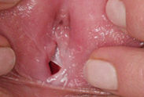

Slide 15
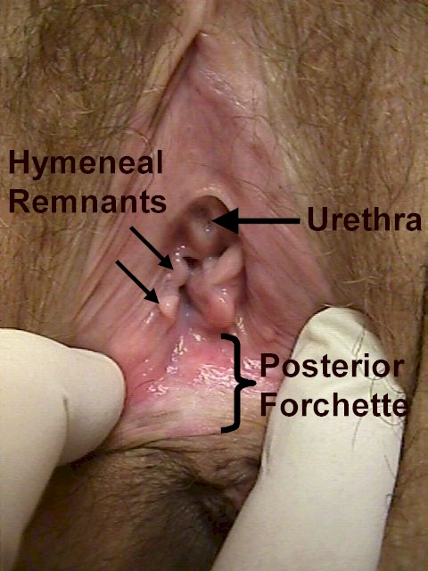

Slide 16
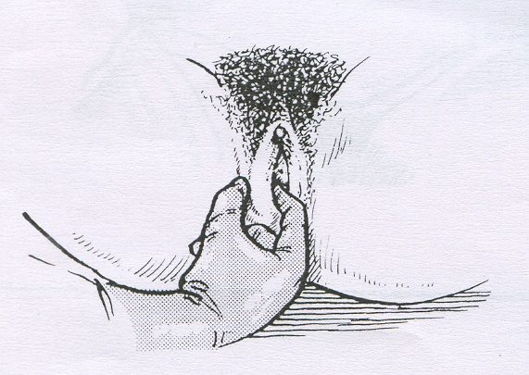
Inspect the following structures:
    a) Mon Pubis - observe pubic hair distribution
    b) Labia Majora/Minora - observe for inflammation, ulceration, swelling or nodules
  c)Clitoris - observe for masculinization
  2cms)
  d)Urethral Orifice - observe for prolapse
  e)Introitus - observe for inflammation, ulcerations, nodules previous episiotomy scar, hymenal status

Slide 17
  Ask the patient to strain (like defecation) and/or cough
Observe for signs of stress incontinence and/or abnormal bulging of anterior and/or posterior walls of vagina
Abnormal finding include
  a) Urethrocele
  b) Cystocele
  c) Rectocele
  d) Enterocele

Slide 18
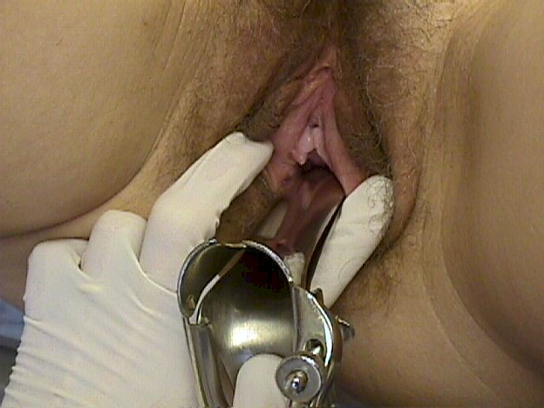

Slide 19
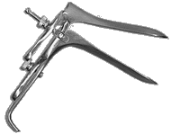
Speculum Examination
The Handle
The Bills
Thumb Lever
Thumb Nut

Slide 20
Speculum techniques
  a) Warm with water (do not use lubricant since it will interfere with PAP smear)
  b) Touch inner thigh with speculum and ask patient if it is too warm or too cold
  c) Ask patient to spread knees laterally to relax perineal musculature
  d) Press fingers on perineal body and assess relaxation
  e) Make sure blades are closed and thumbscrew loosened
  f) Gently insert index finger and assess location of cervix (anterior vs. posterior)
    (1) anteverted uterus = posterior cervix
    (2) retroverted uterus = anterior cervix

Slide 21
    g) Insert gently at 45-degree angle (pointing towards sacrum)
    (1) avoid pinching vulva/introitus
    (2) avoid sensitive urethra and anterior vaginal wall
    h) Gently open speculum and attempt to
    visualize cervix
    (1) if not visualized, assess speculum location by looking for anterior vaginal wall (rugated)
      (2) if rugations seen, close speculum and insert more posteriorly (cervix will usually “pop” into view)
      i) Once cervix visualized, open blades more and stabilize by tightening thumbscrew

Slide 22
Inspect the cervix
  a) Observe position, prolapse, location of transformation zone, type of cervical os (multiparous vs. nulliparous), ulcers, color, polyps, plaques, contact bleeding, abnormal discharge, or bleeding from cervical os, cysts and nodules
  b) Abnormal findings include:
  (1) Ectropion
  (2) Nabothian cysts
  (3) Pelvic inflammatory disease (purulent discharge)
  (4) Cervicitis
  (5) Herpetic cervicitis
  (6) Cervical polyp
  (7) Previous obstetrical lacerations
  (8) Cervical carcinoma
  (9) Cervical prolapse
  (10) Chadwick’s sign ( bluish tint
(11) Spontaneous miscarriage

Slide 24
Perform PAP smear:
  a) Take three separate specimens and place on three separate slides (attempt to minimize contamination from mucous and/or blood)
  (1) Cervical scrape: use spatula and scrape transformation zone in rotary fashion
  (2) Endocervical swab/brush: insert into endocervical canal, rotate and remove
  (3) Vaginal pool: collect cells from posterior fornix with swab
  b) Apply fixative to slide immediately
  c) If abnormal vaginal discharge present, take swab of fluid in order to perform a wet mount for viewing under microscope

Slide 25
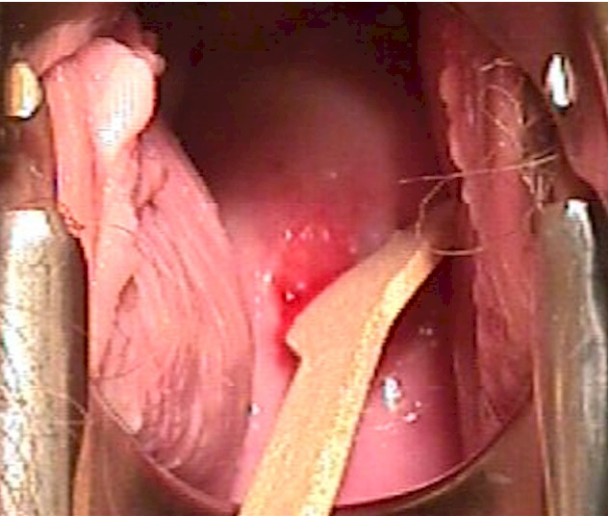

Slide 26
Cultures and Wet Mounts
Must use Dacron Q tip and turn in os and leave in os at least 20 seconds.
Wet mounts
Obtain cultures for GC/clamydia (Gynprobe)
  Trichamonas = Saline
  Yeast, Bacterial Vaginosis + - KOH
  Determine pH with Nitrazine or pH paper (normal is 4.5 and below)
  “Whiff” test for amine odor characteristic of Bacterial Vaginosis

Slide 27
Inspect vaginal mucosa
  a) Loosen thumbscrew but keep speculum partially open during withdraw in order to inspect vaginal mucosa
  b) Inspect for color, degrees of rugations (transverse ridges), plagues, malodorous discharge, strawberry spots, white patches, cysts, ulcers, nodules and fistulae

Slide 28
Vaginal mucosa
1. Normal: pink, rugated, pliable.
  thin, clear fluid (from cervical secretions).
2. Abnormal: fluid characteristics (odor, color, consistency, quantity).

Slide 29
Common abnormal findings include
  a) Foreign bodices (children)
  b) Atrophic vaginitis (red, loss of ruga)
  c) Monilial vaginitis (white curds)
  d) Trichomonas vaginitis (strawberry spots)
  e) Gardnella vaginitis (malodorous, foamy)
  f) Vaginal cancer
  g) Cervicouterine prolapse
  h) Cervical displacement due to pelvic/uterine mass
  i) Gartner duct cysts (lateral sidewalls)

Slide 30
Bimanual exam of vagina, cervix, uterus and adnexia

Slide 31
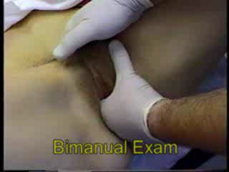

Slide 32
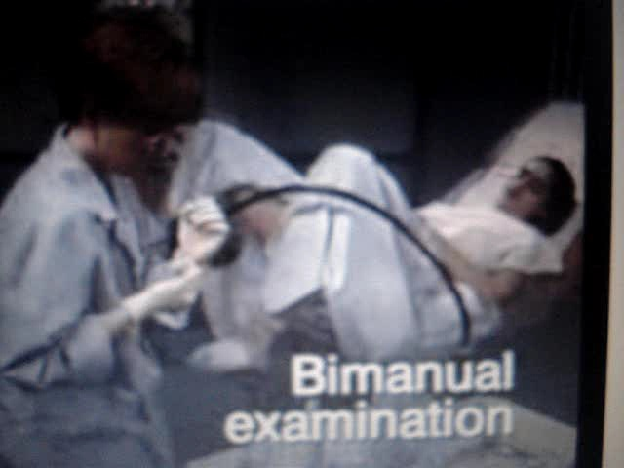

Slide 33
Bimanual exam
Announce what you are going to do and then touch the patient on the thigh with the back of your hand before proceeding.
Insert your index and middle fingers. Avoid contact with the anterior structures.
Place your other hand on the patient's lower abdomen

Slide 34
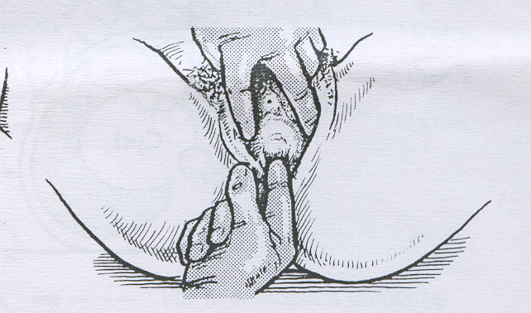
:
Palpate the following structures
a) Inguinal area - appreciate abnormal lymph adenopathy
  b) Labia Majora - appreciate Bartholin gland (pea size)
  c) Perineum/introitus - appreciate perineal body thickness and vaginismus
  d) Urethra - gently palpate (“milk”) intra vaginal portion

Slide 35

Palpate the upper labia majora for masses related to hernias extending through the Canal of Nuck.
Palpate the middle and lower portion of the labia majora for masses suggesting a Bartholin Duct Cyst.

Slide 36
Common findings include:
  a) Delayed Tanner staging
  b) Sebaceous cysts
  c) Condyloma Acuminata (venereal warts)
  d) Syphilitic chancre
  e) Condyloma Lata (secondary syphilis)
  f) Genital Herpes
  g) Monilial vulvitis
  h) Vulvar dystrophy
  i) Vulvar carcinoma (plaques, nodules, ulcers)
  j) Skene’s adenitis
  k) Bartholin abscess
  l) Bartholin cyst
  m) Inguinal lymphadenopathy
  n) Urethral carbuncle
  o) Urethral diverticulum

Slide 37
Palpate vagina and cervix
  a) Lubricate index and middle finger of dominant gloved hand. Abduct thumb and flex remaining digits.
  b) Insert lubricated fingers into vagina and note vaginal cyst/masses/plaques.
  c) Abnormal findings include:
  (1) Cervical displacement by pelvic mass
  (2) Cervical motion tenderness
  (3) Softening due to pregnancy
  (4) Unobserved vaginal pathology

Slide 38
Cervix
determine color, size, shape, consistency and mobility:
  1. Normal: 2-3 cm in size.
    pink, smooth epithelium.
    old bilateral scars may be seen.
    squamocolumnar junction
  2. Abnormal: ulceration, growths.
    eversion of cervical lips
    endocervical epithelium may brow out onto vaginal portion of cervix.
    Nabothian cysts are of little clinical importance.

Slide 39

Examine the Cervix
Palpate the cervix with your index finger noting size, shape, and consistency.
Gently move the cervix side to side between your fingers and note mobility and tenderness.
Gently lift the cervix forward and note mobility and tenderness.

Slide 40
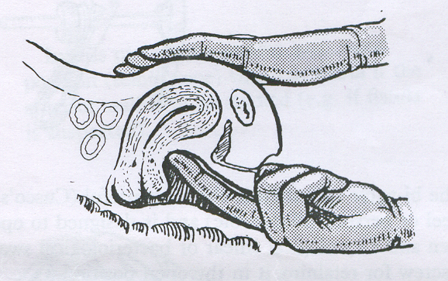
The Uterus
  Five important characteristics of the uterus:
    a. Size (large or small)
    b. Shape (irregular contour, enlarged, nodular)
    c. Position (normal: uterus is at right angles to long axis of vagina; variations: retroflex, retroverted, ).

Slide 41
Palpate uterus via bimanual exam
  Separate the labia minora
  Insert the fingers of one hand into the vagina; depress the perineum to get more room.
  a)Press external hand gently on the lower abdomen (on the anterior of the fundus) and with the finger on either side of the cervix, attempt to outline the uterus

Slide 42

b) Document the following normal findings:
  (1) Size - should be about the size of a small orange or baseball.
  (2) Position - anteverted (80%)
  (a) anteflexed
  (b) midaxial
  (c) retroverted (20%)
  (d) retroflexed
  (3) Contours - smooth and regular/small AP diameter
  (4) Consistency - firm
  (5) Mobility - mobile in all places
  (6) Tenderness - essentially non-tende
  (7) Cul-de-sac - no masses behind uterus

Slide 43
  (1) Ovarian size - normal ovaries 2x2 cms.
  (2) Ovarian shape - almond shape
  (3) Adnexal tenderness - slight tenderness
  (4) Adnexal mobility - very mobile
  (1) Pathologic ovarian cyst: enlarged, bilateral, distensible, > 4 cms.
  (2) Functional ovarian cyst: < 4 cms., regular contour, distensible
  (3) Ovarian Cancer: enlarged, irregular, bilateral contiguous with uterus
  (4) Pelvic adhesions: decreased mobility
  (5) Ectopic pregnancy: mass tender
  (6) Endometriosis: decreased mobility, possible mass

Slide 44
  (1) rectal sphincter tone
  (2) rectal masses
  (3) Recto vaginal septum
  (4) cul-de-sac masses
  (5) posterior uterine contours
  (6) fundal uterine contours
  (7) hem occult

Slide 45
Common abnormal findings include
(Bimanual examination)
  a) Move abdominal wall laterally and move vaginal fingers into lateral fornices. Attempt to entrap adnexal structures between fingertip. Repeat contra lateral side.
  b) Note the following normal findings:
  c) Abnormal findings include:
  a) Change gloves and place lubricated middle finger in rectum and index finger in vagina. Sweep from side to side and use abdominal hand to bring uterus and adnexa towards vaginorectal hand.
  b) Evaluate:
  3. Palpate Adnexa via bimanual exam

Slide 46
4. Recto vaginal Exam
  (1) rectal CA
  (2) Recto vaginal fistula - weak septum,
  express stool through vagina
  (3) fundal/posterior fibroids
  (4) cul-de-sac mass

Slide 47
  (1) Pregnancy - enlarged, soft, globular
  (a) 8-week size: large orange
  (b) 10-week size: at symphysis
  (c) 20-week size: at umbilicus
  (2) Fibroids - enlarged, irregular firm contours
  (3) Extreme retroversion
  (a) unable to palpate with abdominal hand, instead fundus palpated in cul-de-sac
  (b) significant tenderness

Slide 48
  (4) Adenomyosis - soft, globular, tender uterus
  (5) Uterine Cancer - enlarged soft uterus with abnormal uterine bleeding
  (6) Pelvic adhesions-decreased mobility
  (7) Uterine prolapse - cervix in lower vagina
  (8) Postmenopausal uterine atrophy - small uterus
  (9) Endometritis - tender, boggy uterus

Slide 49
Finishing Up
Replace the drape and assist the patient to remove her feet from the stirrups and sit up.
Reassure the patient, if the exam is normal, say so.
Leave the room and allow the patient to dress before continuing with the consultation

Slide 57


